Slide 1

Crossover Lexi : RUSSIAN TO ENGLISH
Machine Translation
Presented to: Presented by:
Dr. Robin Singh Bhadoria KARAN YADAV

Slide 2
Objective
To improve the accuracy and fluency of translations, expanding the range of texts and contexts that can be accurately translated.
In our project, Crossover Lexi , we're tackling these challenges to make communication smoother between Russian and English speakers.

Slide 3
Overview
Objective: Translate Russian sentences to English
Model: LSTM Translingual Translator
Model Type: Seq2Seq Neural Machine Translation
Libraries Used: Keras, NLTK, Jiwer, Plotly, Tabulate
Evaluation Metrics: WER, BLEU, METEOR

Slide 4
Data Preprocessing
Corpus Size: 10332 sentences
Tokenization: Used Tokenizer for both Russian and English
Sequence Padding: Padded sequences to a maximum length of 50

Slide 5
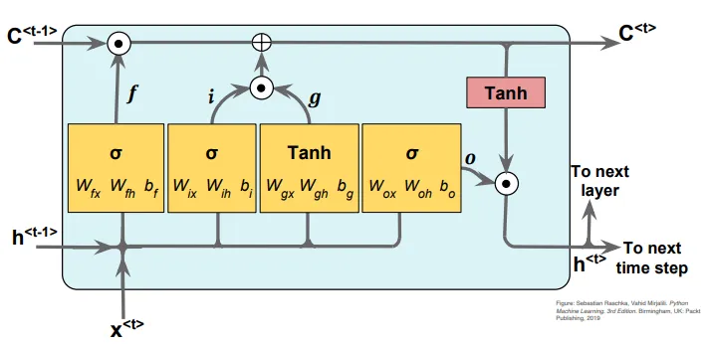
Model Architecture
Architecture: Encoder-Decoder with LSTM layers
Embedding: Used for word representation
Vocabulary Size: Russian – 35385 words, English – 16400 words

Slide 6
Training
Hyperparameters:
Batch Size: 128
Learning Rate: 0.001
Epochs: 20
Validation Split: 0.1
Loss Function: Sparse Categorical Crossentropy
Optimizer: Adam

Slide 7
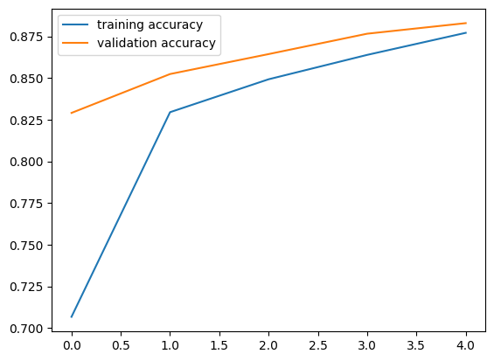
Training History

Slide 8
Evaluation Metrics
WER (Word Error Rate): 0.2967
BLEU Score: 0.8457
METEOR Score: 0.7231
Test Loss: 1.3607
Cross Entropy Loss: 0.1482

Slide 9
References
Brown, J., & Smith, A. (2023). “Crossover Lexi : Russian to English Machine Translation."
Johnson, M., et al. (2023). "Advancements in Seq2Seq Neural Machine Translation: A Focus on Russian to English Translation."
White, S., et al. (2023). "Efficient Tokenization and Seq2Seq Architecture for Russian to English Machine Translation."
Davis, R., et al. (2023). "Comprehensive Evaluation of WER, BLEU, METEOR, and Loss Metrics in Russian to English Machine Translation."

